Slide 1
Corporate Overview
Vectrae Infotech Pvt. Ltd
Dinesh Kumar, Managing Director
Notes:
www.Vectrae.com

Slide 2
Inspirations…
Notes:
www.Vectrae.com

Slide 3
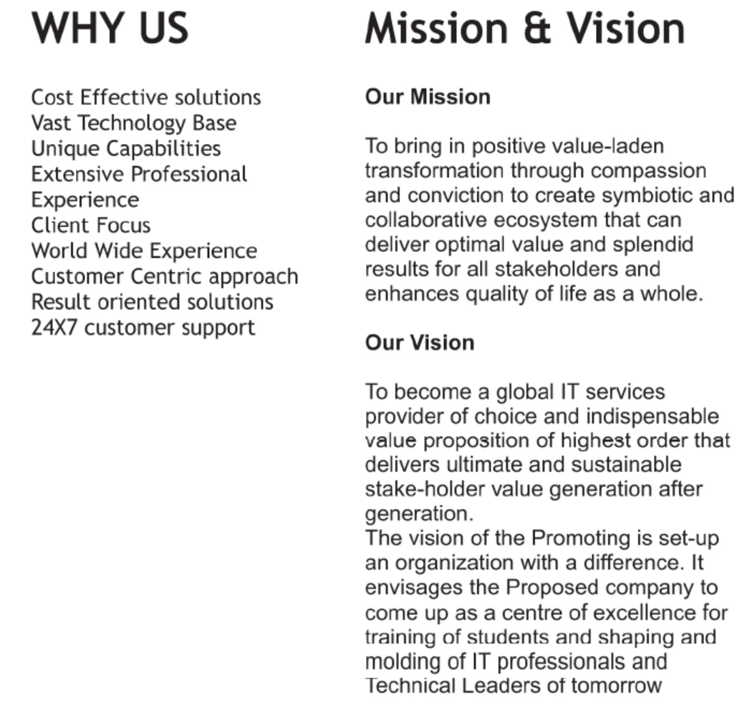
About Us
Notes:
www.Vectrae.com

Slide 4
Notes:
www.Vectrae.com

Slide 5
Priorities
Participate
Modernizing India
Bridge the Digital
Divide
Innovate
Our
Approach
Transformative Technologies
Supporting for growth of
Startup India & Digital India
Notes:
www.Vectrae.com

Slide 6
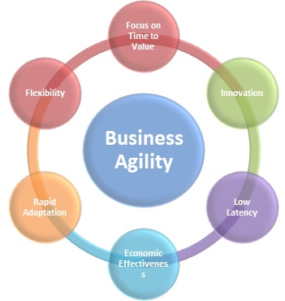
Our Business Values
Notes:
www.Vectrae.com

Slide 7
Focus Areas
IT
Hardware & IT Accessories
AMC
Offerings
Networking
Onsite IT Support
Mobility
Infrastructure
Solutions
Notes:
www.Vectrae.com

Slide 8
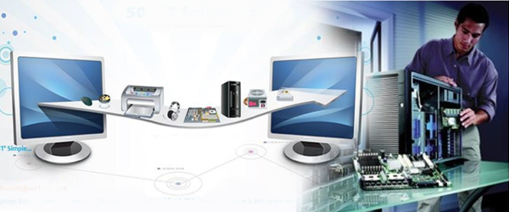
Infrastructure Solutions
End To End Solutions
Desktops, Laptops, Printers, Scanners, Tablet, LFD, VDI, Projectors & IT Peripherals.
Servers & Storage - Tower, Rack, Blade, NAS & SAN Storage.
Networking : Structure Cabling, Wireless Setup.
Power Solution - Online & Offline UPS, Inverter & Battery Bank.
Video Conferencing- All Board Room and Huddle Room Solutions.
Security & Surveillance.
Warehousing & Asset Management Solutions.
Notes:
www.Vectrae.com

Slide 9
Our Technology Partners
Notes:
www.Vectrae.com

Slide 10
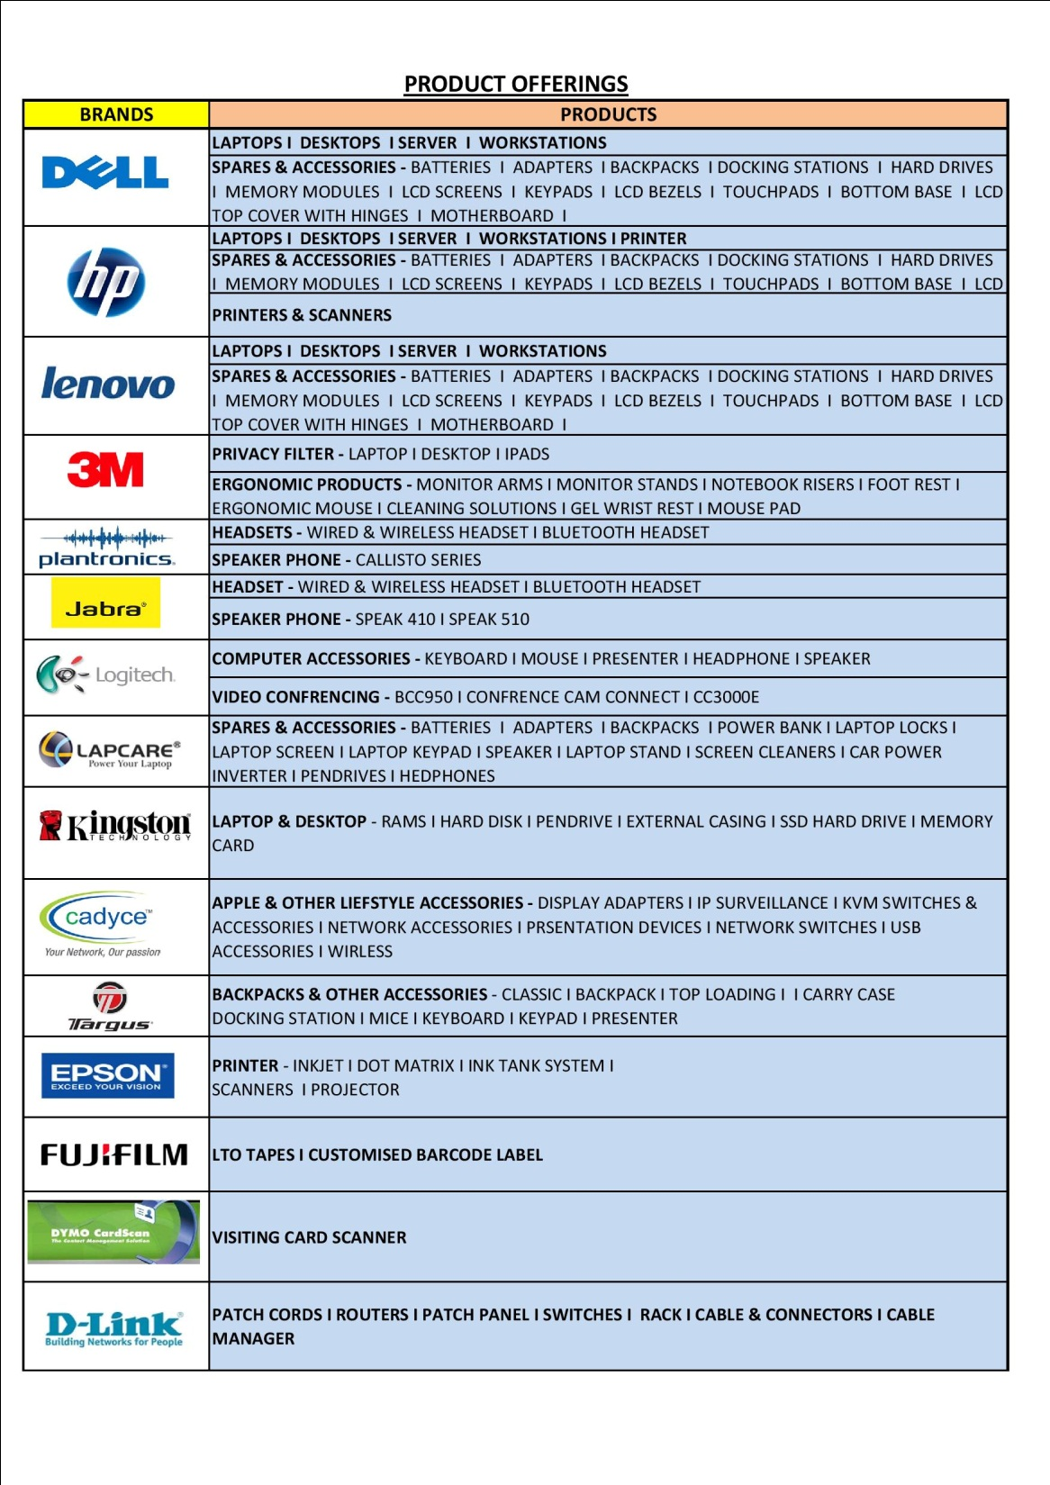

Slide 11
Our iconic Customers
Notes:
www.Vectrae.com

Slide 12
Why Vectrae
Goal
Team, Innovate
and Excel
Leverage on
Domain Skills &
Technical Know How
Enabling Clients
Success
Unwavering Dedication
Win Win Proposition
Our Steps of Passion
Notes:
www.Vectrae.com

Slide 13
Our Winning Proposition
We Need Opportunity to Prove ….
Notes:
www.Vectrae.com

Slide 14
Thank you.
www.Vectrae.com
For your precious time and your attention.
VECTRAE INFOTECH PVT. LTD.
DELHI-NCR l BANGALORE l MUMBAI l HYDERABAD l PUNE
Notes:
www.Vectrae.com

